Slide 1


Top Discriminator Efficiencies and Signal Over Bkg for several selection Categories NTUA
Giannis Papakrivopoulos
George Bakas

Slide 2
Overview
Efficiencies vs mTTbarParton
Signal over Background for
Mtt samples over Bkg
Nominal sample over Bkg
Yields for all samples
All Signal over Bkg are vs mJJ
Categories:
1. Both jets are top tagged and b tagged
2. 1 Jet top and b tagged and other jet top tagged
3. 1 Jet top and b tagged and other jet b tagged
4. Both jets are top tagged
5. Both jets are b tagged
Cuts:
Reco:
nJets > 1,
|jetEta| < 2.4 (both jets)
jetPt > 400 GeV (both jets)
120 GeV < jetMassSoftDrop < 220 GeV (both jets)
Parton:
|etaParton| < 2.4 (both partons)
ptTopParton > 400 GeV (both partons)
mTTbarParton > 1000

Slide 3
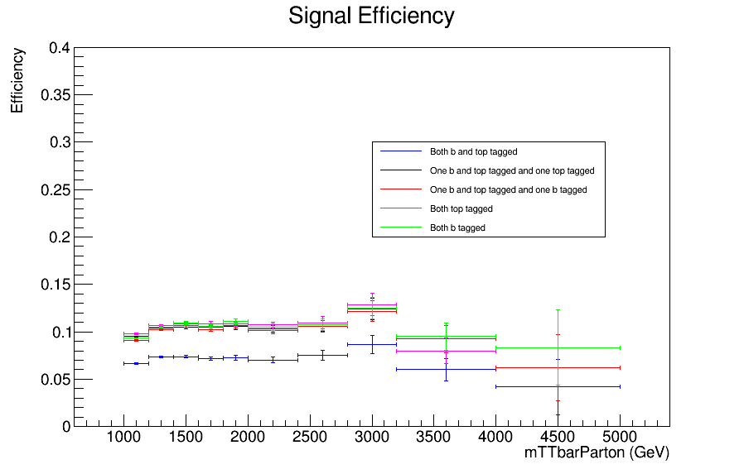
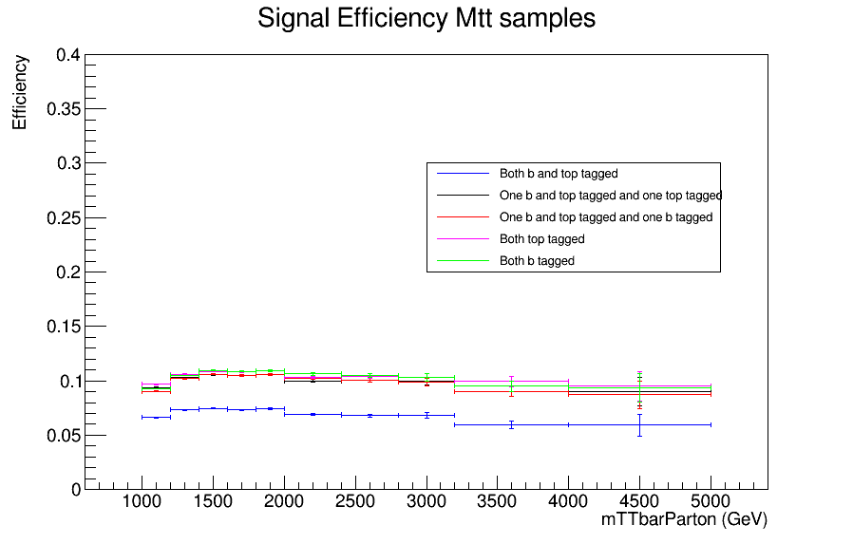
Efficiency vs mTTbarParton
Top tagger cut : 0.0
B-tagging: Loose working point
nominal TT_TuneCUETP8M2T4_13TeV-powherg-pythia8
Mtt Samples

Slide 4
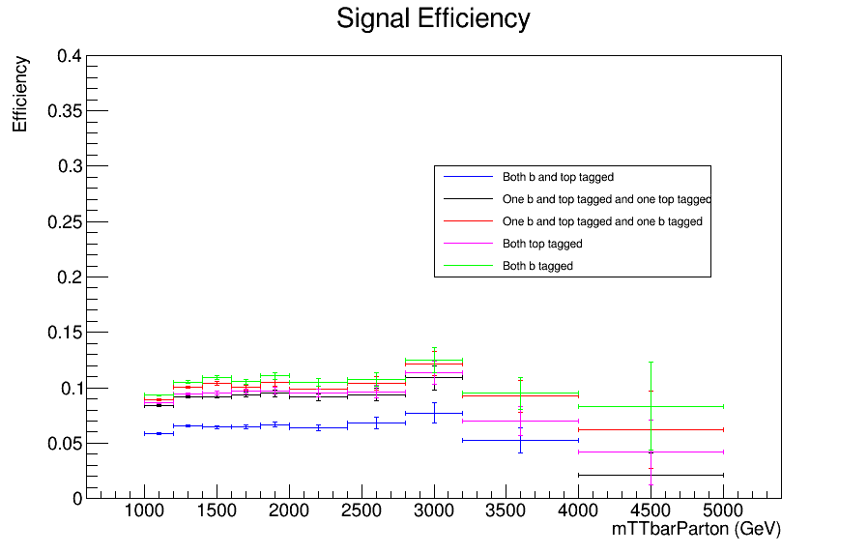
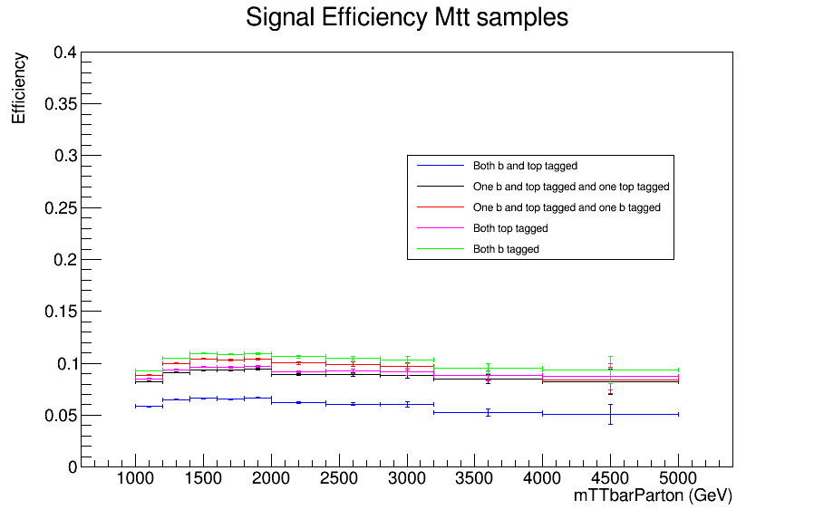
Efficiency vs mTTbarParton
Top tagger cut : 0.1
B-tagging: Loose working point
nominal TT_TuneCUETP8M2T4_13TeV-powherg-pythia8
Mtt Samples

Slide 5
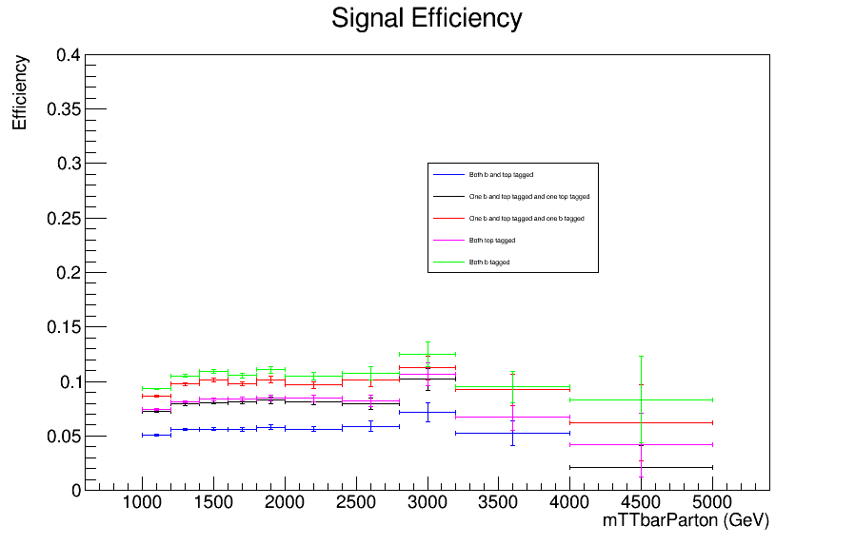
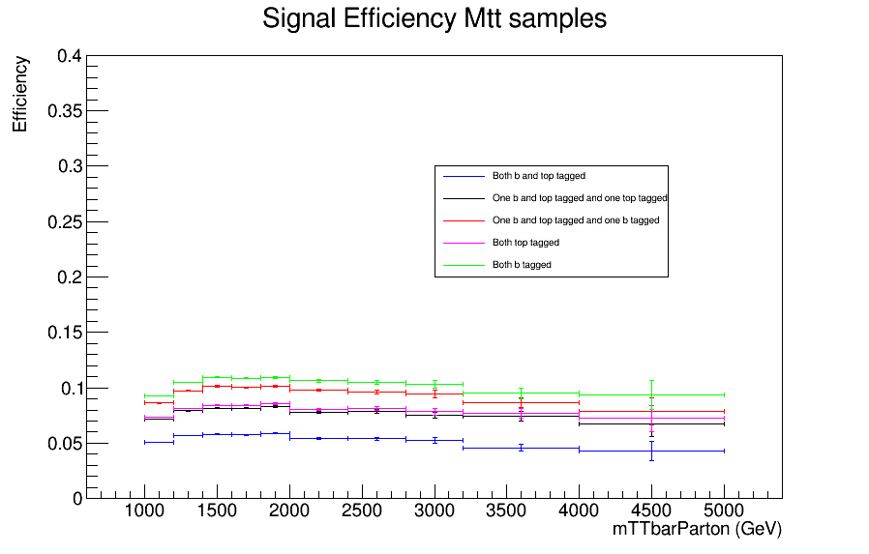
Efficiency vs mTTbarParton
Top tagger cut : 0.2
B-tagging: Loose working point
nominal TT_TuneCUETP8M2T4_13TeV-powherg-pythia8
Mtt Samples

Slide 6
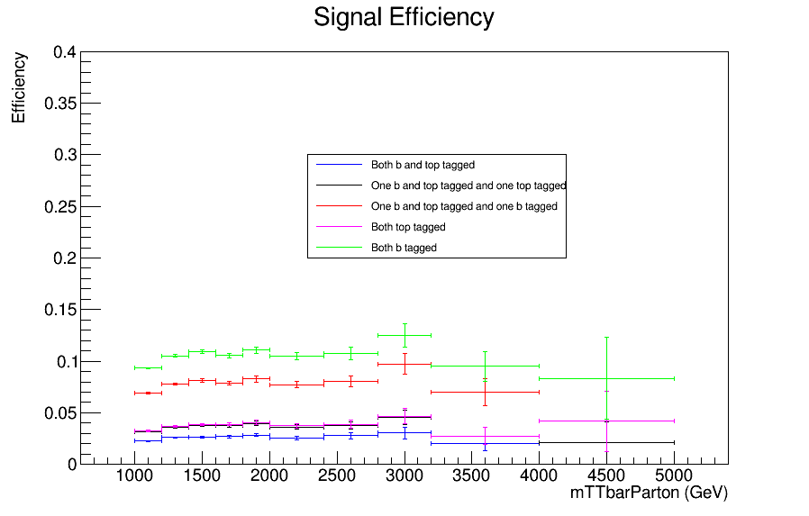
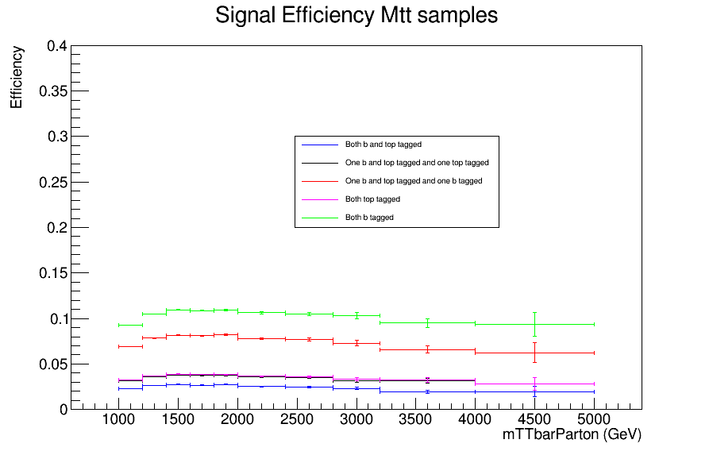
Efficiency vs mTTbarParton
Top tagger cut : 0.6
B-tagging: Loose working point
nominal TT_TuneCUETP8M2T4_13TeV-powherg-pythia8
Mtt Samples

Slide 7
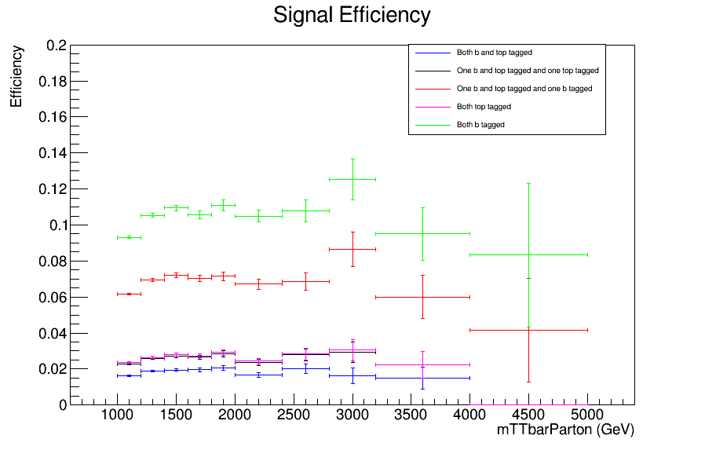
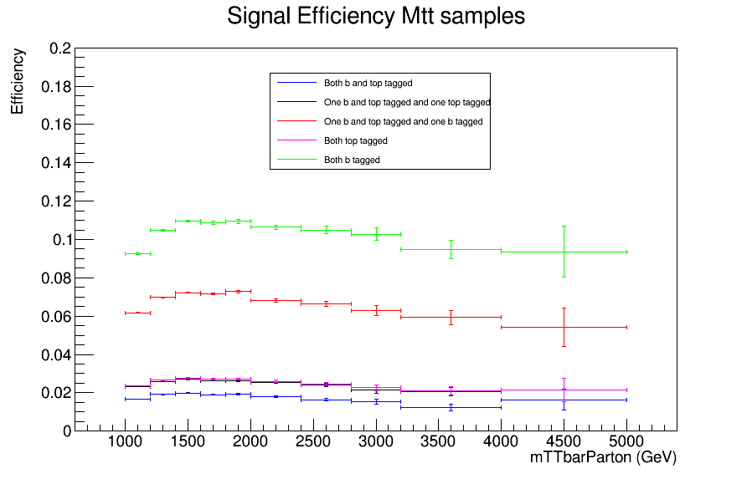
Efficiency vs mTTbarParton
Top tagger cut : 0.7
B-tagging: Loose working point
nominal TT_TuneCUETP8M2T4_13TeV-powherg-pythia8
Mtt Samples

Slide 8
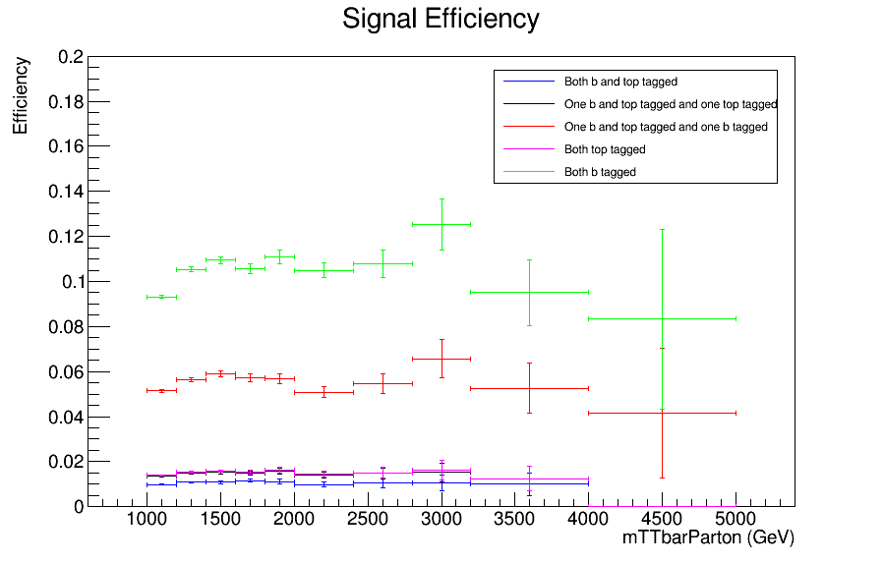
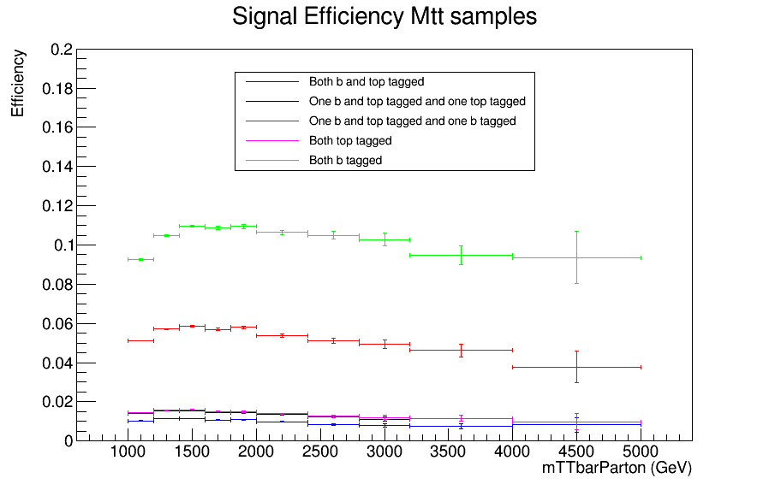
Efficiency vs mTTbarParton
Top tagger cut : 0.8
B-tagging: Loose working point
nominal TT_TuneCUETP8M2T4_13TeV-powherg-pythia8
Mtt Samples

Slide 9
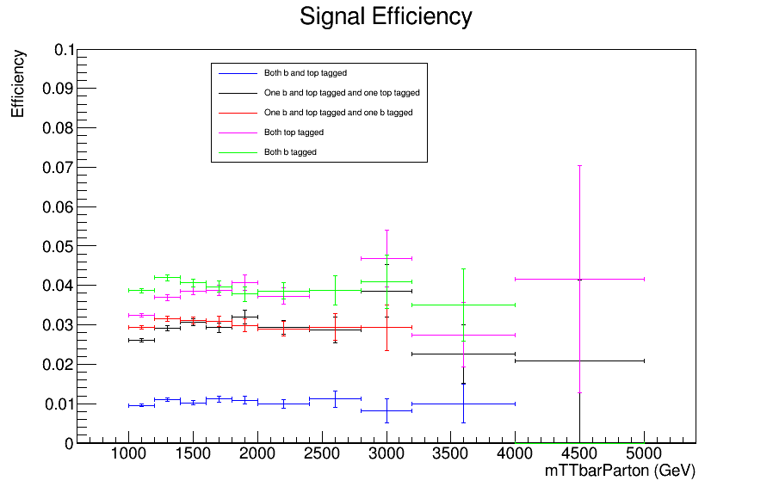
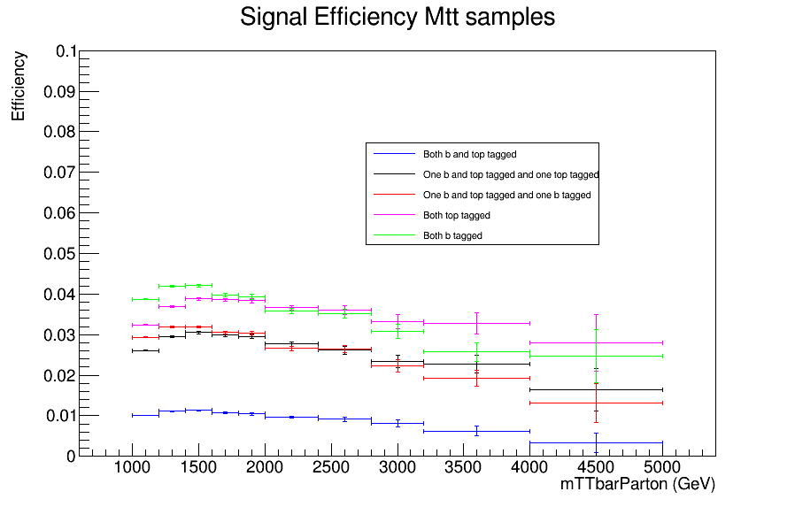
Efficiency vs mTTbarParton
Top tagger cut : 0.6
B-tagging: Medium working point
nominal TT_TuneCUETP8M2T4_13TeV-powherg-pythia8
Mtt Samples

Slide 10
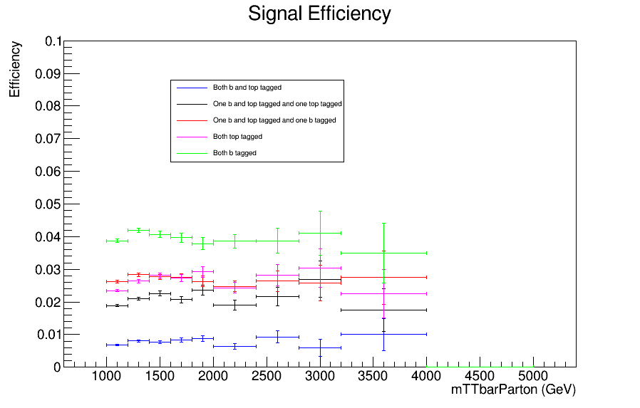
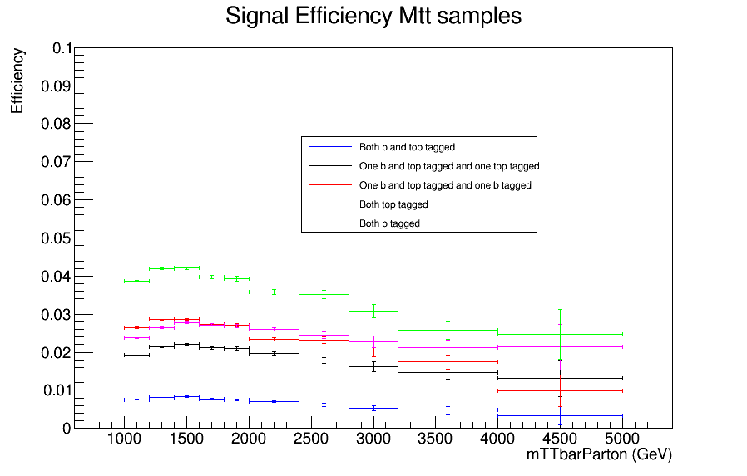
Efficiency vs mTTbarParton
Top tagger cut : 0.7
B-tagging: Medium working point
nominal TT_TuneCUETP8M2T4_13TeV-powherg-pythia8
Over Bkg (All Categories)
Mtt Samples

Slide 11
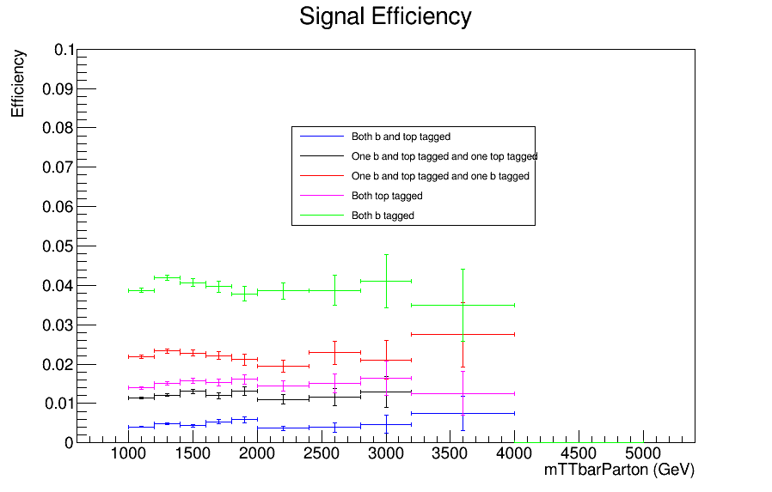
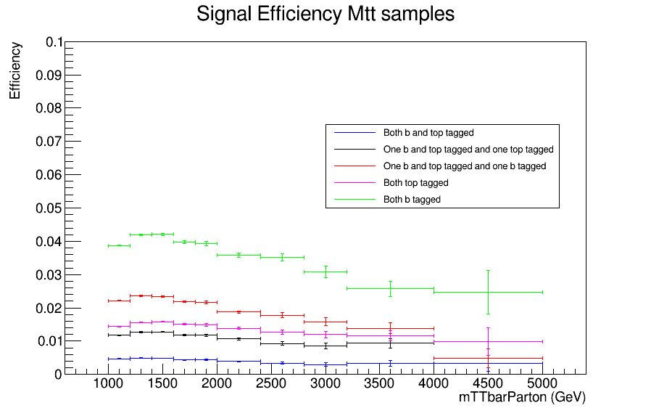
Efficiency vs mTTbarParton
Top tagger cut : 0.8
B-tagging: Medium working point
nominal TT_TuneCUETP8M2T4_13TeV-powherg-pythia8
Mtt Samples

Slide 12
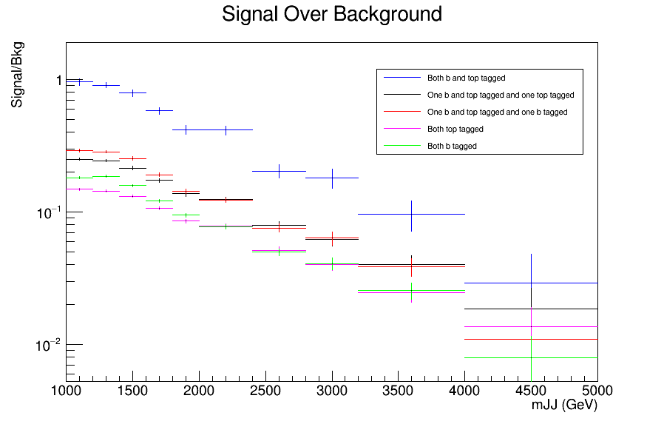
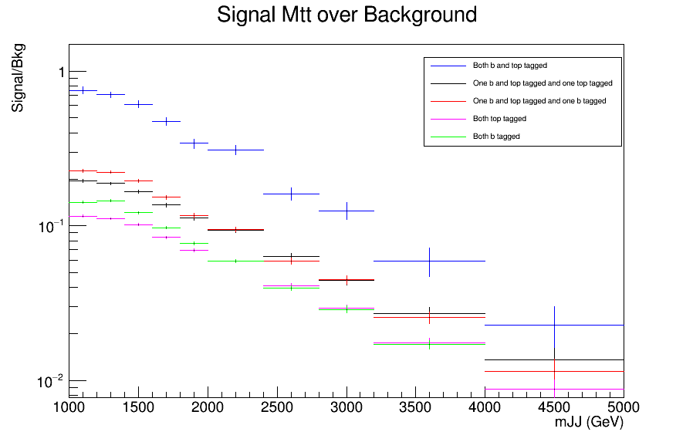
Signal over Bkg for mJJ (reco)
Top tagger cut : 0.0
B-tagging: Loose working point
nominal TT_TuneCUETP8M2T4_13TeV-powherg-pythia8
Over Bkg (All Categories)
Mtt Samples

Slide 13
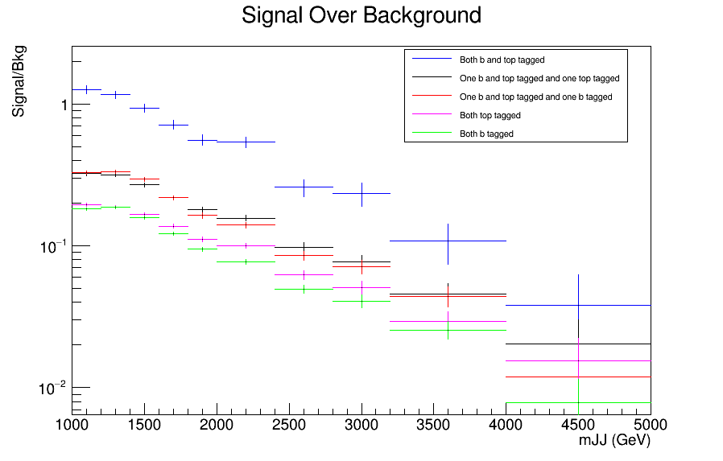
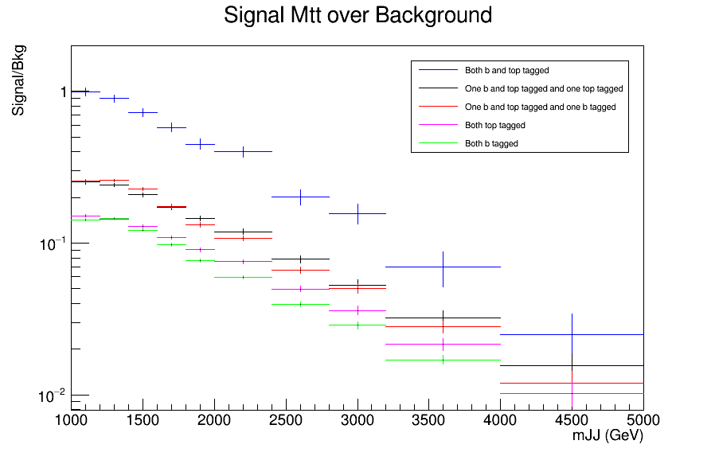
Signal over Bkg for mJJ (reco)
Top tagger cut : 0.1
B-tagging: Loose working point
nominal TT_TuneCUETP8M2T4_13TeV-powherg-pythia8
Over Bkg (All Categories)
Mtt Samples

Slide 14
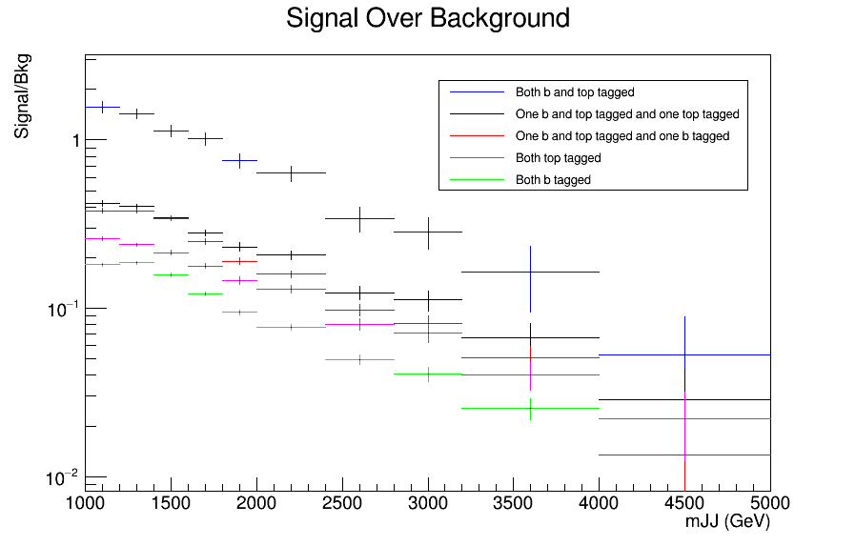
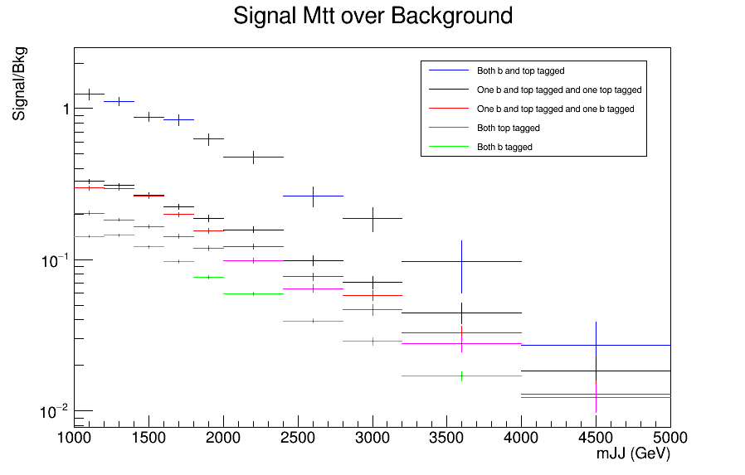
Signal over Bkg for mJJ (reco)
Top tagger cut : 0.2
B-tagging: Loose working point
nominal TT_TuneCUETP8M2T4_13TeV-powherg-pythia8
Over Bkg (All Categories)
Mtt Samples

Slide 15
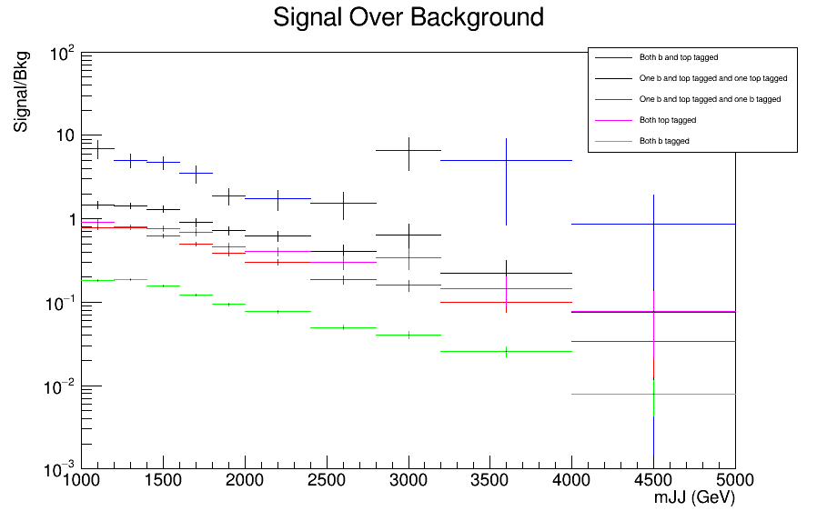
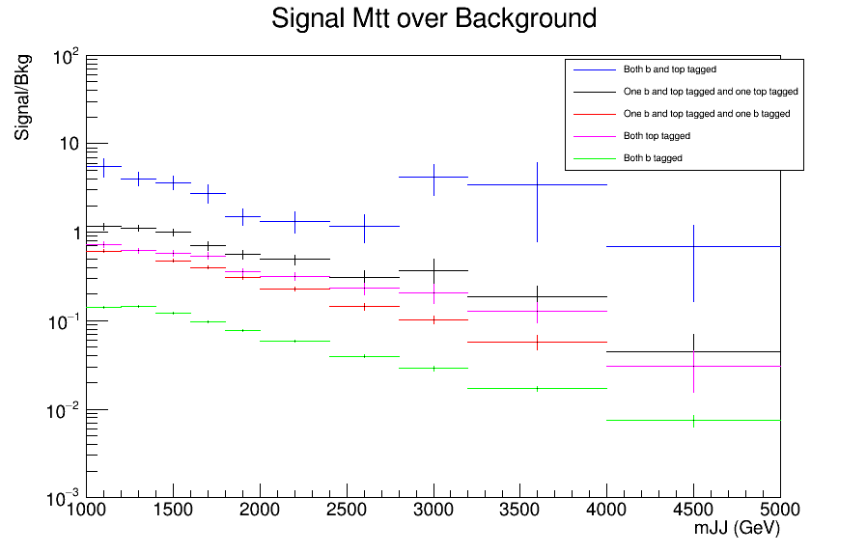
Signal over Bkg for mJJ (reco)
Top tagger cut : 0.6
B-tagging: Loose working point
nominal TT_TuneCUETP8M2T4_13TeV-powherg-pythia8
Over Bkg (All Categories)
Mtt Samples

Slide 16
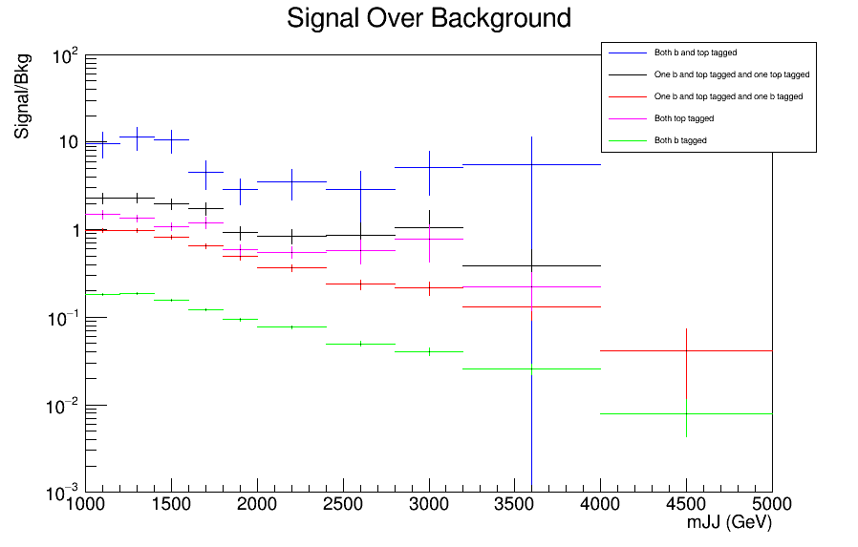
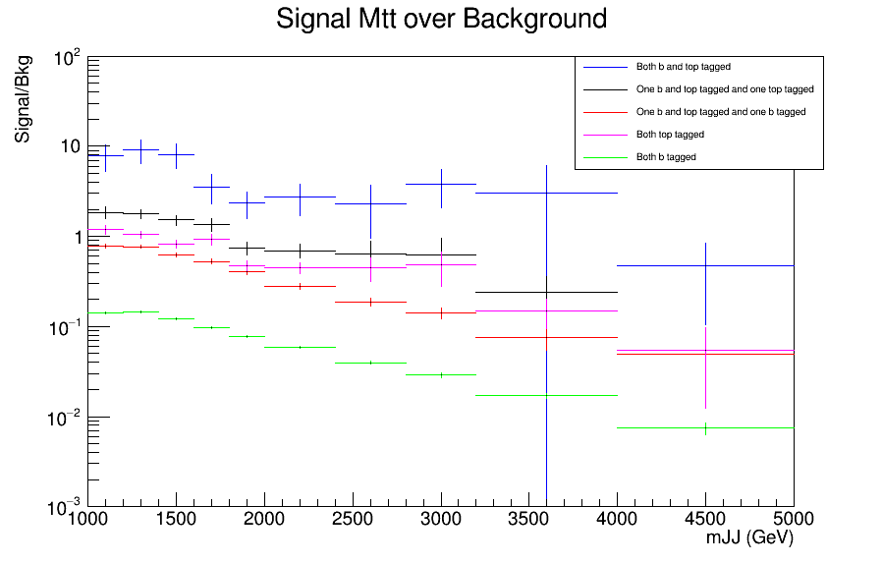
Signal over Bkg for mJJ (reco)
Top tagger cut : 0.7
B-tagging: Loose working point
nominal TT_TuneCUETP8M2T4_13TeV-powherg-pythia8
Over Bkg (All Categories)
Mtt Samples

Slide 17
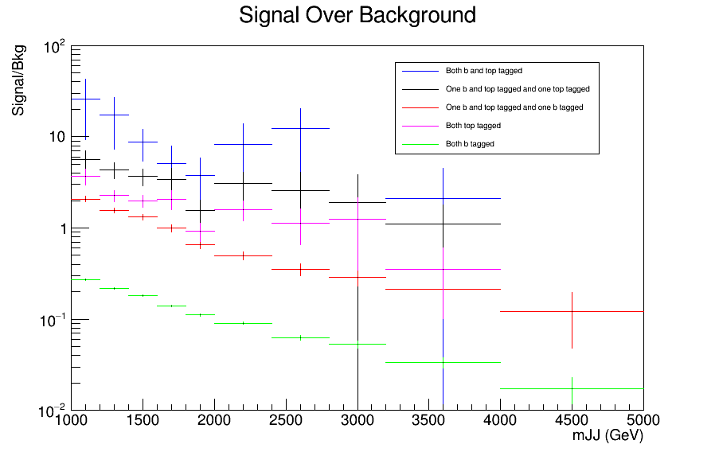
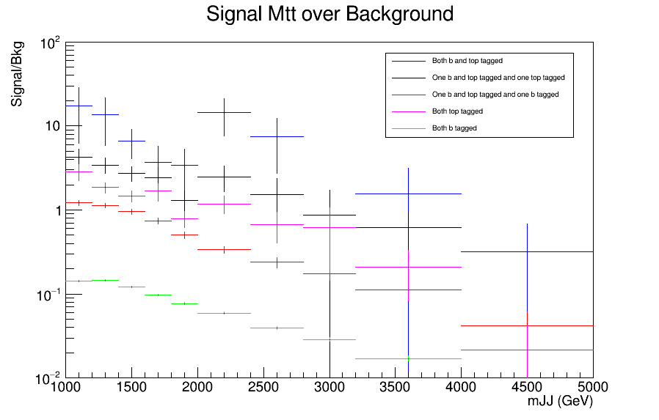
Signal over Bkg for mJJ (reco)
Top tagger cut : 0.8
B-tagging: Loose working point
nominal TT_TuneCUETP8M2T4_13TeV-powherg-pythia8
Over Bkg (All Categories)
Mtt Samples

Slide 18
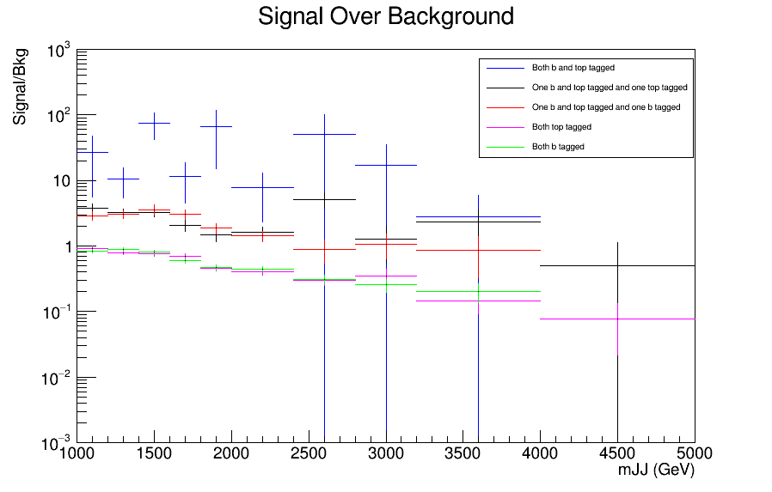
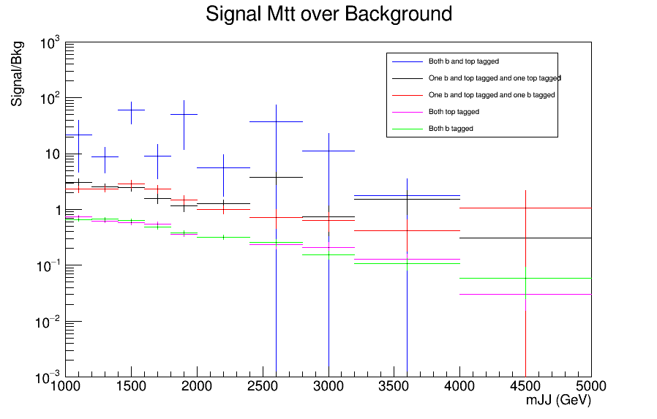
Signal over Bkg for mJJ (reco)
Top tagger cut : 0.6
B-tagging: Medium working point
nominal TT_TuneCUETP8M2T4_13TeV-powherg-pythia8
Over Bkg (All Categories)
Mtt Samples

Slide 19
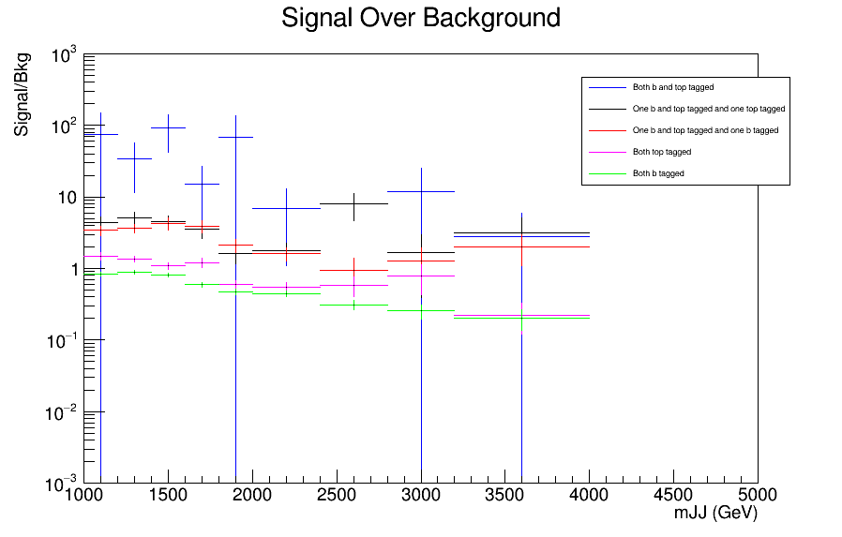
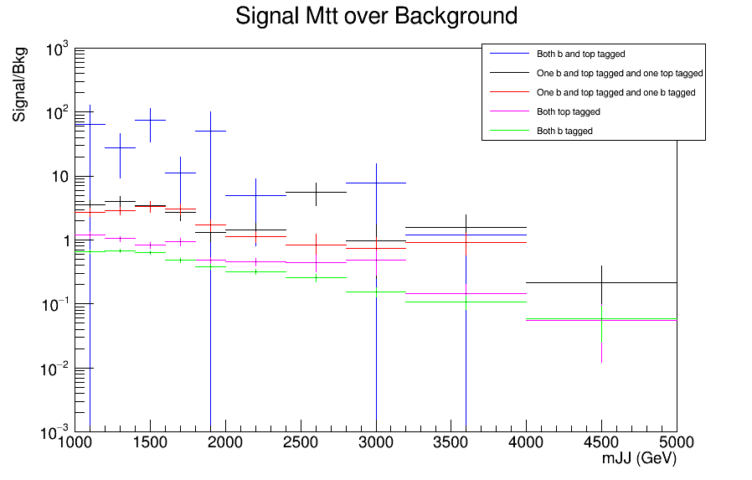
Signal over Bkg for mJJ (reco)
Top tagger cut : 0.7
B-tagging: Medium working point
nominal TT_TuneCUETP8M2T4_13TeV-powherg-pythia8
Over Bkg (All Categories)
Mtt Samples

Slide 20
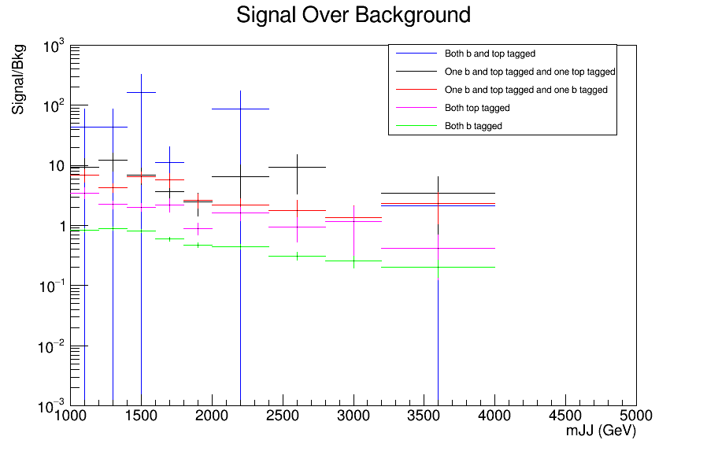
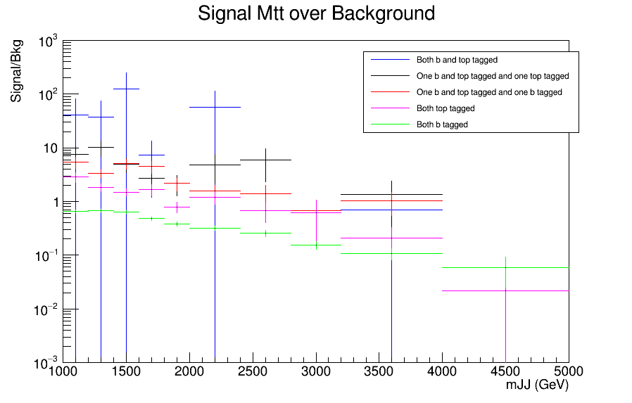
Signal over Bkg for mJJ (reco)
Top tagger cut : 0.8
B-tagging: Medium working point
nominal TT_TuneCUETP8M2T4_13TeV-powherg-pythia8
Over Bkg (All Categories)
Mtt Samples

Slide 21
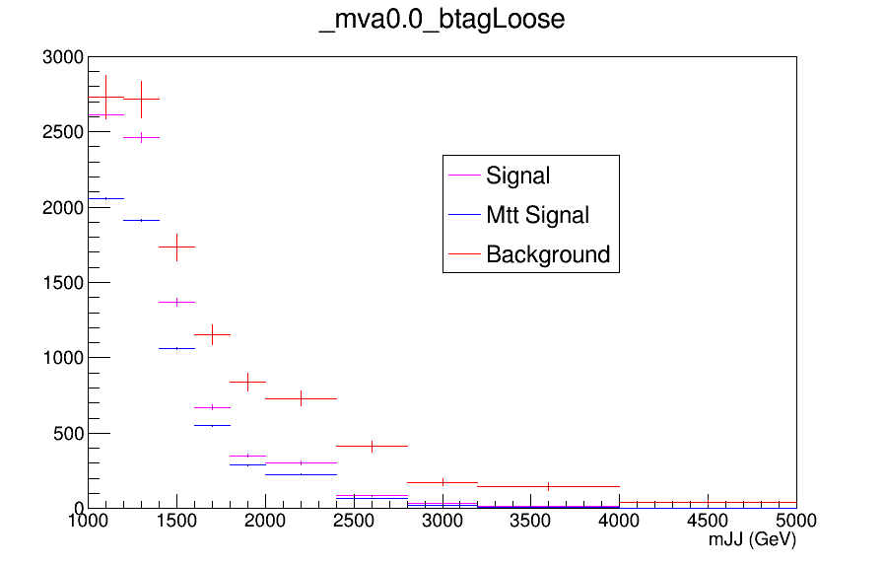
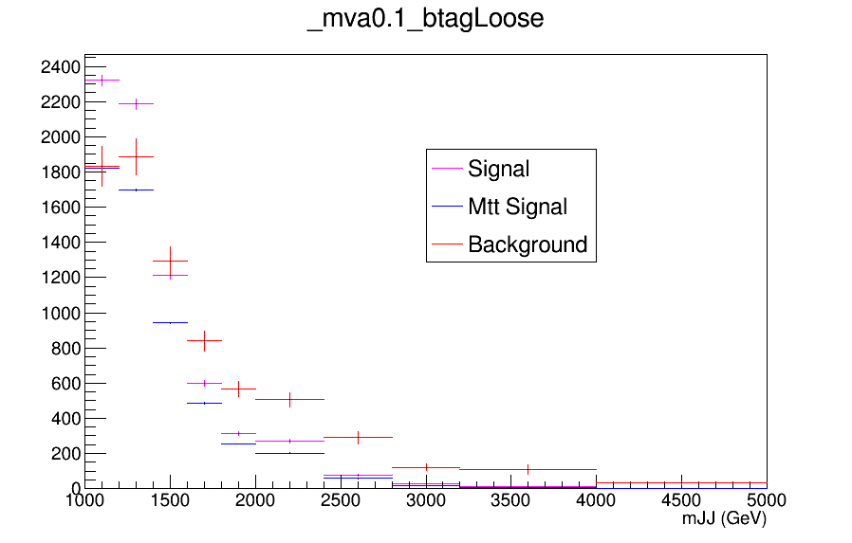
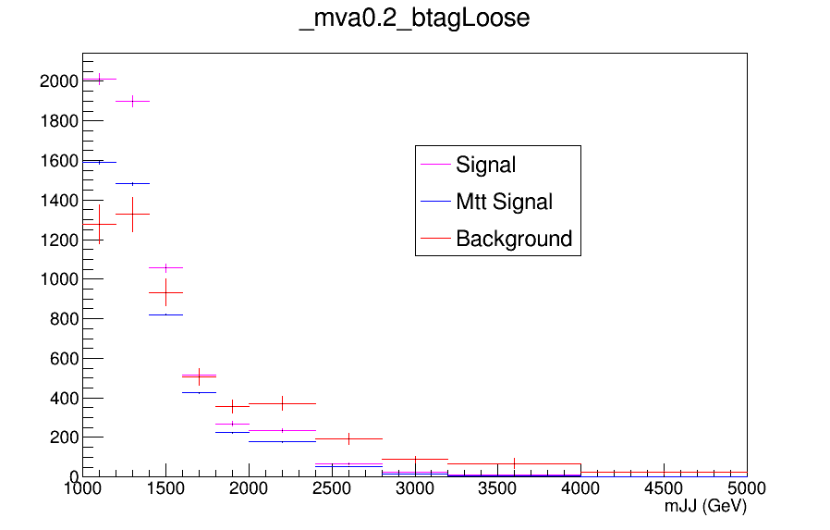
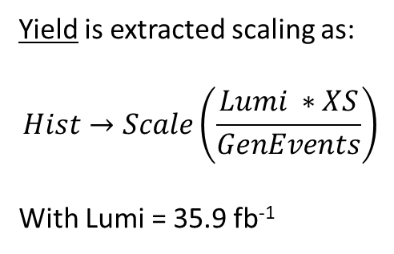
Yields for Combinations of mva and b tagging
Yield is extracted scaling as:
$$Hist→Scale\left(\frac{Lumi ∗XS}{GenEvents}\right)$$
With Lumi = 35.9 fb⁻¹

Slide 22
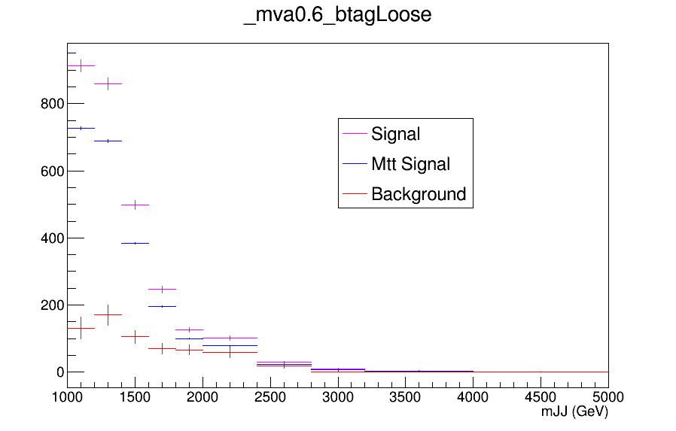
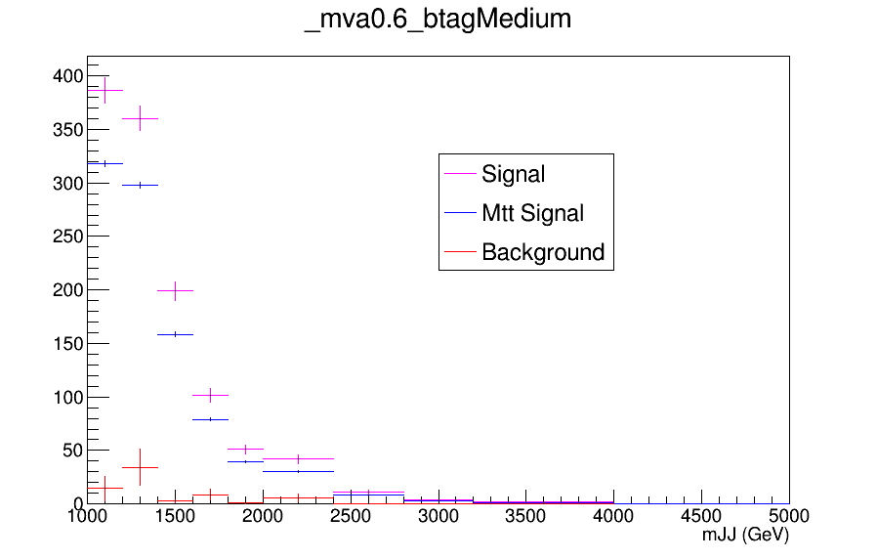
Yields for Combinations of mva and b tagging

Slide 23
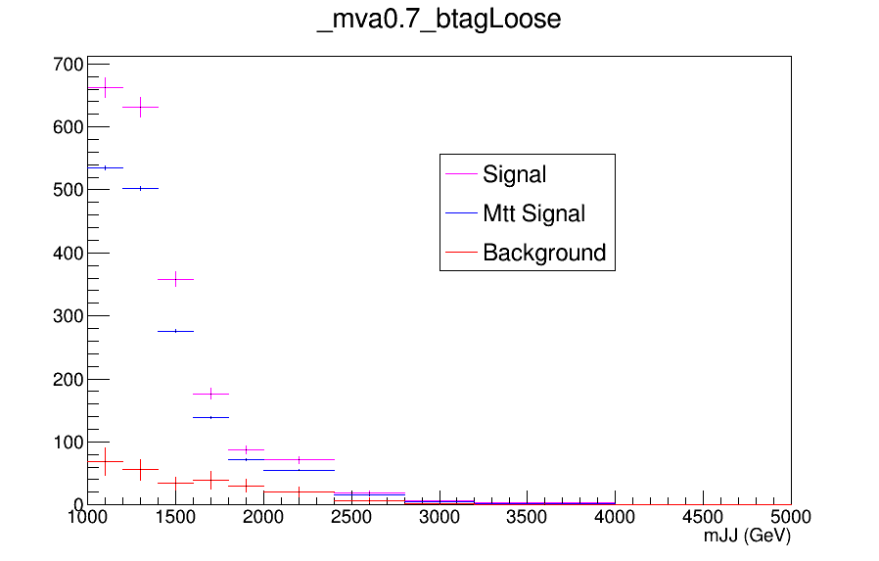
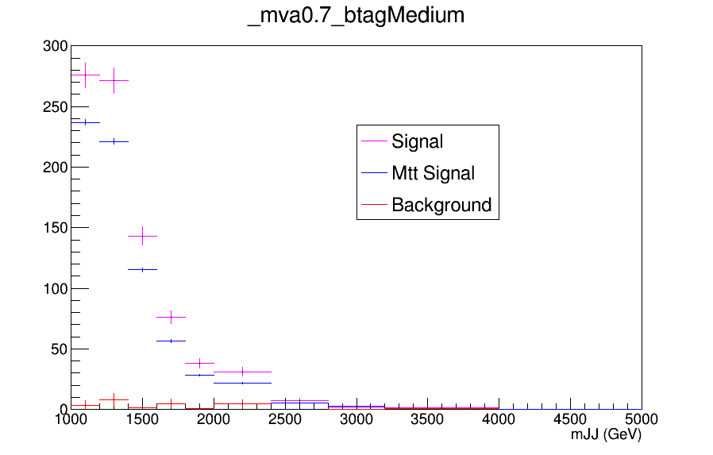
Yields for Combinations of mva and b tagging

Slide 24
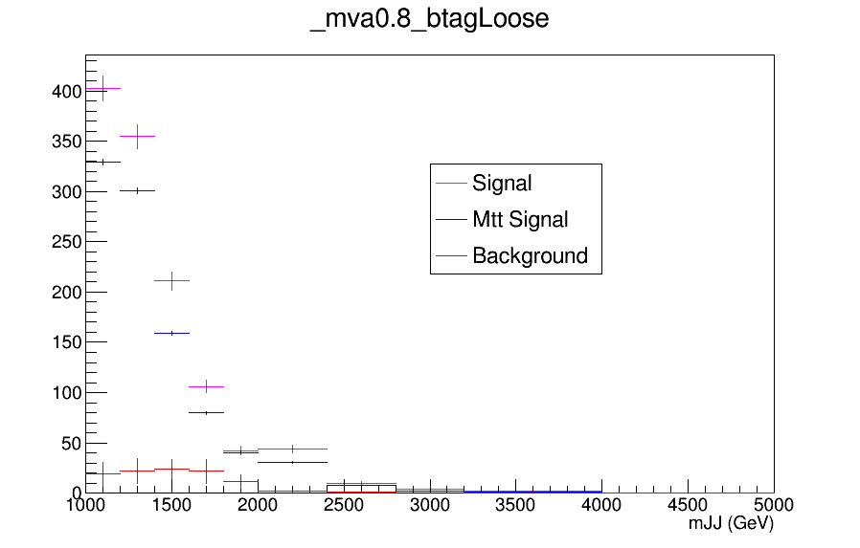
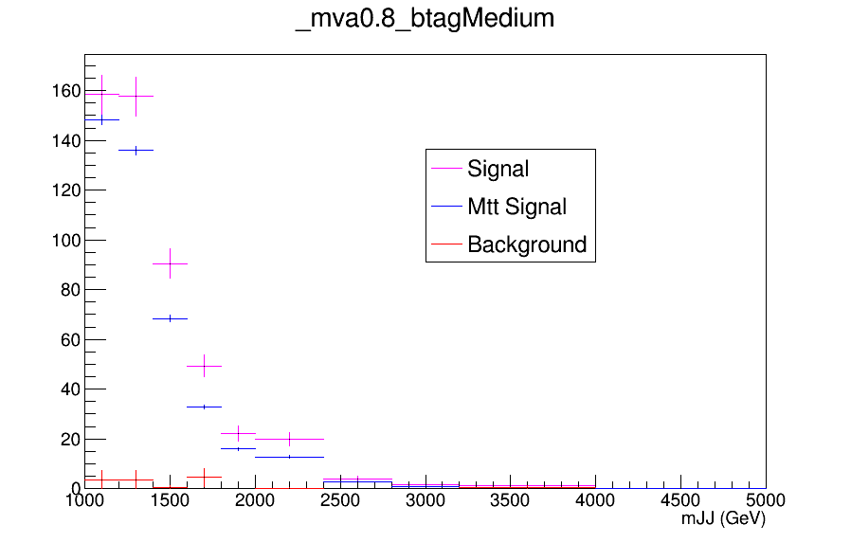
Yields for Combinations of mva and b tagging

Slide 25
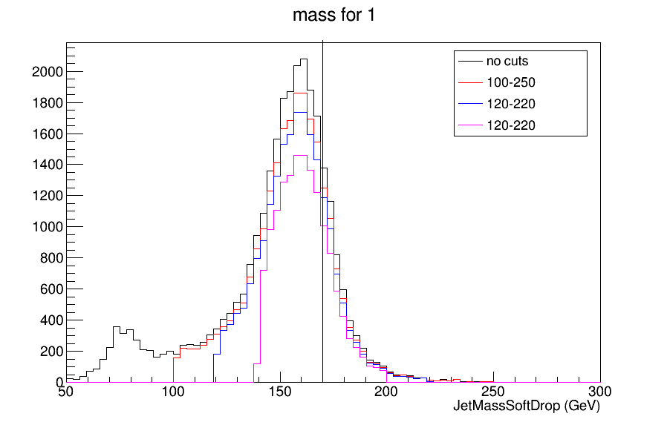
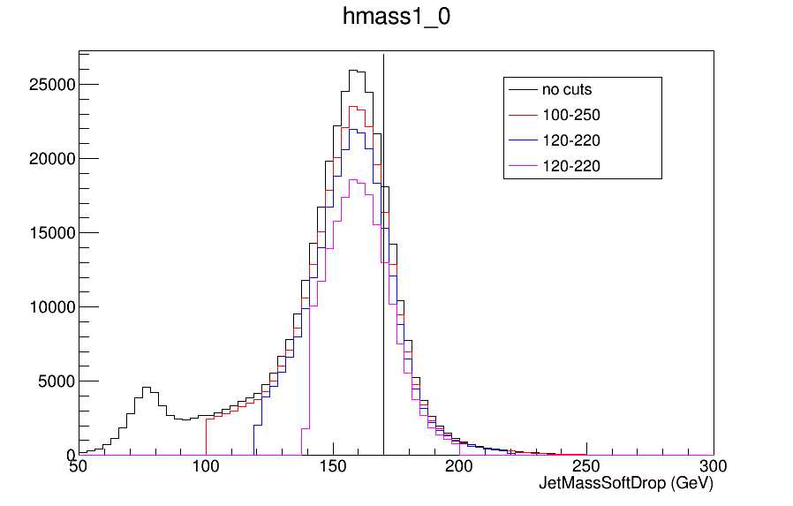
JetMass Soft Drop for different mass windows
The line is located at 170 GeV to show that the mass peak is shifted to the left. (For the nominal Sample):
Mean value with no cuts: 147.509 GeV
Mean value 100-250: 154.766 GeV
Mean value 120-220: 157.318 GeV
Mean value 140-200: 161.227 GeV
For the MTT sample:
Mean value with no cuts: 147.531 GeV
Mean value 100-250: 154.693 GeV
Mean value 120-220: 157.377 GeV
Mean value 140-200: 161.126 GeV

